Slide 1
5G WIRELESS COMMUNICATION (UEC 719)
Dr. Amit Mishra
Associate Professor,
TIET, Patiala
Dr. Surbhi Sharma
Associate Professor,
TIET, Patiala

Slide 2
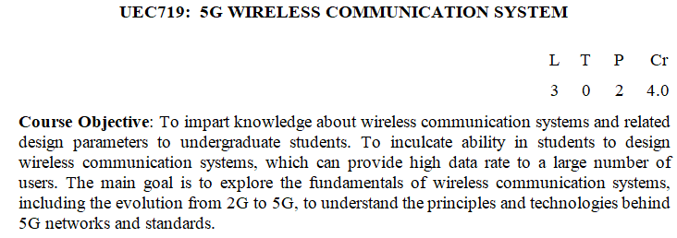
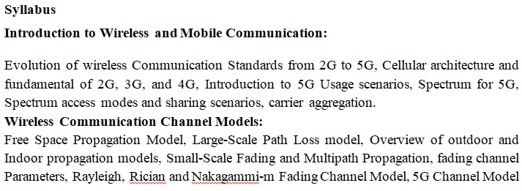

Slide 3
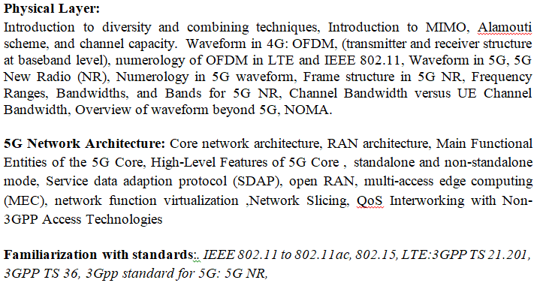

Slide 4
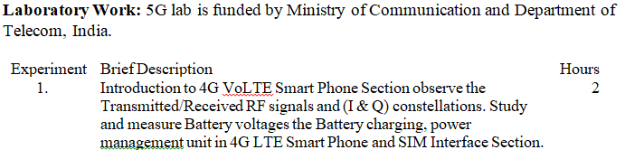
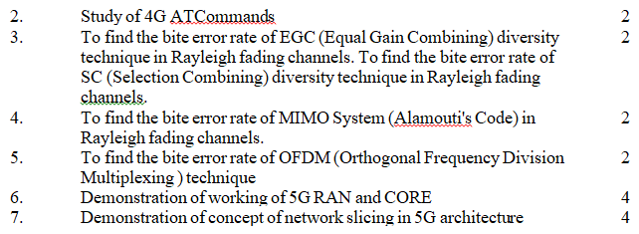

Slide 5
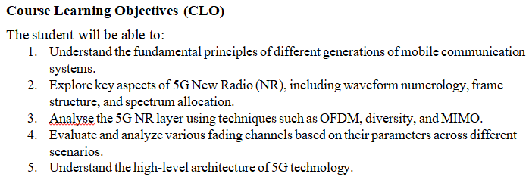

Slide 6
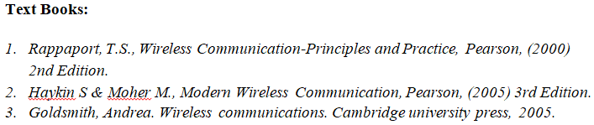
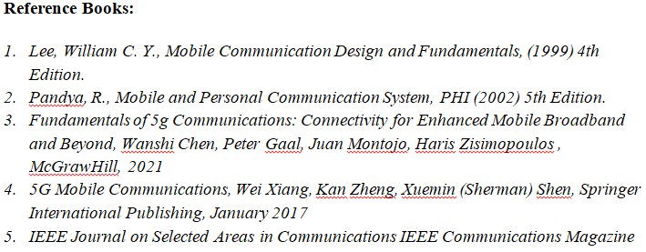

Slide 7
Quiz-1
Evolution of wireless Communication Standards from 2G to 5G

Slide 8
1. What does 1G stand for? A. First Grade B. First Generation C. Fast Generation D. Frequency Generation
2. Which technology was used in 1G? A. GSM B. CDMA C. Analog D. LTE
3. The primary use of 1G was: A. Video calling B. Voice communication C. SMS and MMS D. Internet browsing
4. What is one major drawback of 1G? A. Low cost B. High data rate C. Poor voice quality and security D. Long battery life
5. In which decade was 1G introduced? A. 1960s B. 1970s C. 1980s D. 1990s
6. Which technology was introduced in 2G? A. LTE B. Analog C. GSM D. CDMA2000
7. 2G networks use which kind of signals? A. Digital B. Analog C. Optical D. Infrared
8. What service was introduced with 2G? A. Voice over IP B. SMS C. Video streaming D. App store

Slide 9
9. What is the typical data rate of 2G? A. Up to 10 Kbps B. Up to 64 Kbps C. 1 Mbps D. 100 Mbps
10. Which of the following is a 2G technology? A. UMTS B. EDGE C. HSPA D. OFDMA
11. Which technology is widely associated with 3G? A. GSM B. LTE C. WCDMA D. OFDM
12. What major service became common with 3G? A. Voice-only calling B. SMS C. High-speed internet access D. Analog video
13, What is the typical data speed of 3G? A. 144 Kbps B. 384 Kbps to 2 Mbps C. 10 Mbps D. 100 Mbps
14. Which of the following is NOT a 3G technology? A. UMTS B. CDMA2000 C. EDGE D. HSPA
15. Which year did 3G begin widespread adoption? A. 1991 B. 1999 C. 2005 D. 2010
16. Which technology is the backbone of 4G? A. LTE B. GSM C. WCDMA D. EDGE

Slide 10
17. What is the maximum theoretical speed of 4G LTE? A. 10 Mbps B. 100 Mbps C. 1 Gbps D. 10 Gbps
18. Which of the following is a key feature of 4G? A. Analog transmission B. IP-based communication C. Circuit switching D. No internet access
19. Which application became popular due to 4G? A. Fax B. Streaming HD videos C. Paging D. Morse code
20. What does LTE stand for? A. Light Transmission Efficiency B. Long-Term Evolution C. Local Transmission Exchange D. Line Termination Equipment
18. What is a key technology enabling 5G? A. GSM B. Circuit switching C. Massive MIMO D. CDMA
19. Which of the following is the highest theoretical speed of 5G? A. 1 Gbps B. 5 Gbps C. 10 Gbps D. 100 Mbps
20. What is the average latency expected in 5G? A. 100 ms B. 50 ms C. 10 ms D. 1 ms
21. Which frequency band is used in 5G mmWave? A. Below 1 GHz B. 1–2 GHz C. 3–6 GHz D. Above 24 GHz

Slide 11
22. Which application is highly supported by 5G? A. Morse code B. HD radio C. Augmented Reality D. Voice-only calling
23. Which generation first introduced internet browsing on mobile phones? A. 1G B. 2G C. 3G D. 4G
24. Which of these is a use case for 5G? A. Slow SMS B. Self-driving cars C. Rotary phones D. Voice paging
25. What challenge does mmWave face in 5G? A. High penetration B. Low cost C. Short range and blockage D. Compatibility with 1G
26. What is a major goal of 5G compared to previous generations? A. Voice clarity B. Fax services C. Low latency and IoT integration D. Analog broadcasting
27. Which mobile generation introduced packet-switching as a key feature? A. 1G B. 2G C. 3G D. 5G
28. Which generation started using digital signal transmission? A. 1G B. 2G C. 3G D. 4G

Slide 12
29. Which generation relies completely on IP-based communication? A. 2G B. 3G C. 4G D. 1G
30. Which generation has the highest spectrum efficiency? A. 2G B. 3G C. 4G D. 5G

Slide 13
Quiz-1: Answers

Slide 14
1. What does 1G stand for? A. First Grade B. First Generation C. Fast Generation D. Frequency Generation
2. Which technology was used in 1G? A. GSM B. CDMA C. Analog D. LTE
3. The primary use of 1G was: A. Video calling B. Voice communication C. SMS and MMS D. Internet browsing
4. What is one major drawback of 1G? A. Low cost B. High data rate C. Poor voice quality and security D. Long battery life
5. In which decade was 1G introduced? A. 1960s B. 1970s C. 1980s D. 1990s
6. Which technology was introduced in 2G? A. LTE B. Analog C. GSM D. CDMA2000
7. 2G networks use which kind of signals? A. Digital B. Analog C. Optical D. Infrared
8. What service was introduced with 2G? A. Voice over IP B. SMS C. Video streaming D. App store

Slide 15
9. What is the typical data rate of 2G? A. Up to 10 Kbps B. Up to 64 Kbps C. 1 Mbps D. 100 Mbps
10. Which of the following is a 2G technology? A. UMTS B. EDGE C. HSPA D. OFDMA
11. Which technology is widely associated with 3G? A. GSM B. LTE C. WCDMA D. OFDM
12. What major service became common with 3G? A. Voice-only calling B. SMS C. High-speed internet access D. Analog video
13, What is the typical data speed of 3G? A. 144 Kbps B. 384 Kbps to 2 Mbps C. 10 Mbps D. 100 Mbps
14. Which of the following is NOT a 3G technology? A. UMTS B. CDMA2000 C. EDGE D. HSPA
15. Which year did 3G begin widespread adoption? A. 1991 B. 1999 C. 2005 D. 2010
16. Which technology is the backbone of 4G? A. LTE B. GSM C. WCDMA D. EDGE

Slide 16
17. What is the maximum theoretical speed of 4G LTE? A. 10 Mbps B. 100 Mbps C. 1 Gbps D. 10 Gbps
18. Which of the following is a key feature of 4G? A. Analog transmission B. IP-based communication C. Circuit switching D. No internet access
19. Which application became popular due to 4G? A. Fax B. Streaming HD videos C. Paging D. Morse code
20. What does LTE stand for? A. Light Transmission Efficiency B. Long-Term Evolution C. Local Transmission Exchange D. Line Termination Equipment
18. What is a key technology enabling 5G? A. GSM B. Circuit switching C. Massive MIMO D. CDMA
19. Which of the following is the highest theoretical speed of 5G? A. 1 Gbps B. 5 Gbps C. 10 Gbps D. 100 Mbps
20. What is the average latency expected in 5G? A. 100 ms B. 50 ms C. 10 ms D. 1 ms
21. Which frequency band is used in 5G mmWave? A. Below 1 GHz B. 1–2 GHz C. 3–6 GHz D. Above 24 GHz

Slide 17
22. Which application is highly supported by 5G? A. Morse code B. HD radio C. Augmented Reality D. Voice-only calling
23. Which generation first introduced internet browsing on mobile phones? A. 1G B. 2G C. 3G D. 4G
24. Which of these is a use case for 5G? A. Slow SMS B. Self-driving cars C. Rotary phones D. Voice paging
25. What challenge does mmWave face in 5G? A. High penetration B. Low cost C. Short range and blockage D. Compatibility with 1G
26. What is a major goal of 5G compared to previous generations? A. Voice clarity B. Fax services C. Low latency and IoT integration D. Analog broadcasting
27. Which mobile generation introduced packet-switching as a key feature? A. 1G B. 2G C. 3G D. 5G
28. Which generation started using digital signal transmission? A. 1G B. 2G C. 3G D. 4G

Slide 18
29. Which generation relies completely on IP-based communication? A. 2G B. 3G C. 4G D. 1G
30. Which generation has the highest spectrum efficiency? A. 2G B. 3G C. 4G D. 5G

Slide 19
Lecture: 1 to 3
Evolution of Mobile Technologies
1G to 6G

Slide 20
Contents
Historical Milestones of Wireless Communication
Classification of mobile communication systems
Zero Generation Telephony
First Generation Mobile Systems
Second Generation Mobile Communication System (2G)
Third Generation (3G) Communication Systems
Fourth Generation (4G) Communication Systems
Fifth Generation (5G) Communication Systems
Beyond 5G

Slide 21
Guglielmo Marconi
Historical Milestones of Wireless Communication

Slide 22
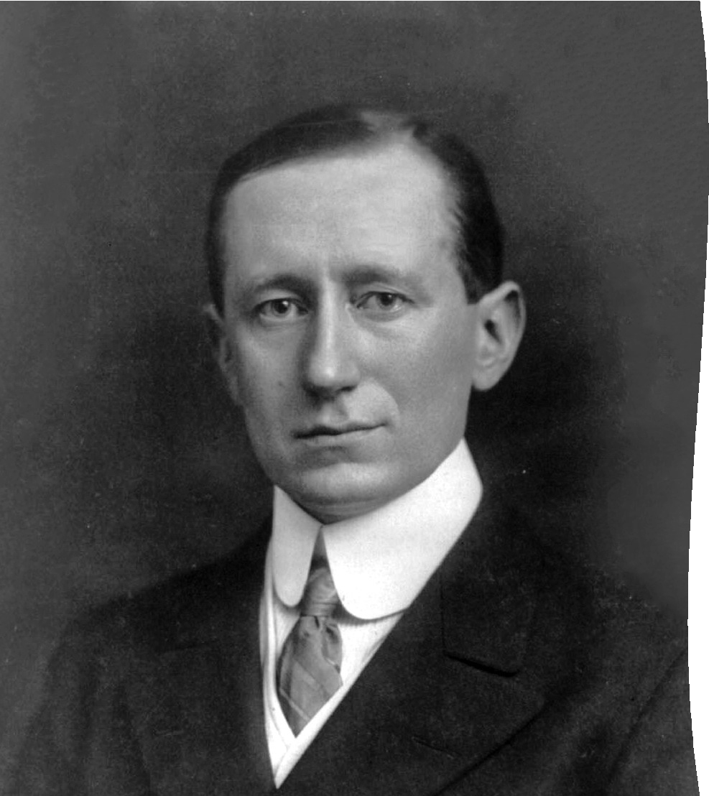
Guglielmo Marconi
Historical Milestones
The first practical use of mobile-radio communication was demonstrated in 1897 by M G Marconi,
He successfully established radio transmission between a land-based station and a tugboat, over an 18 mi path.
Established a communication set up over 3 Km in 1896 using Morse code

Slide 23


Historical Milestones
Claude Shannon
The Shannon capacity theorem defines the maximum amount of information, or data capacity, which can be sent over any channel or medium (wireless, coax, twister pair, fiber etc.)
In information theory, Shannon's source coding theorem (or noiseless coding theorem) establishes the statistical limits to possible data compression for data whose source is an independent identically-distributed (IID) random variable

Slide 24
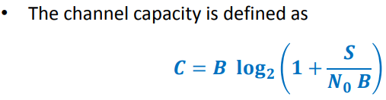
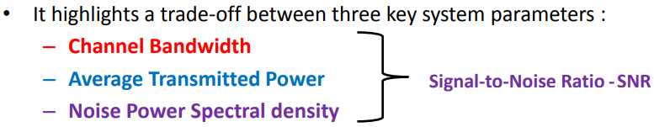
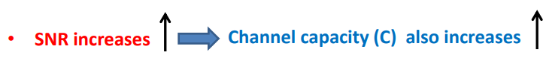
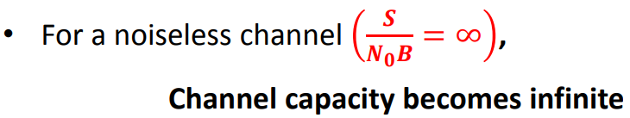

Slide 25

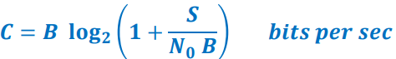
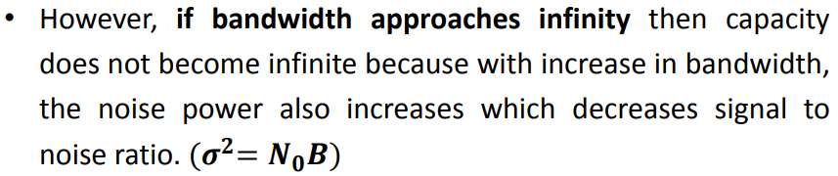
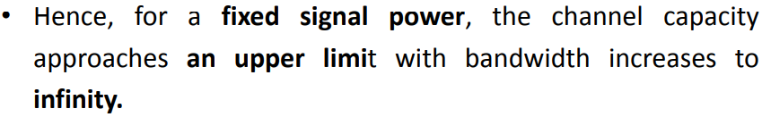

Slide 26

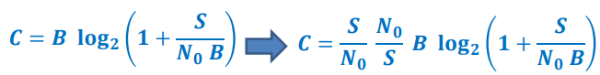
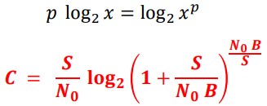
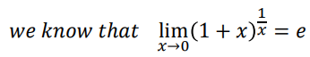
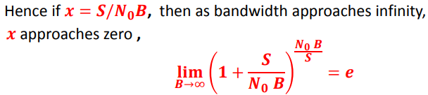

Slide 27
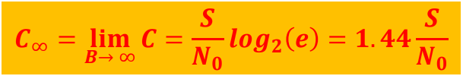
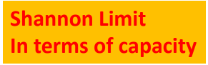

Slide 28
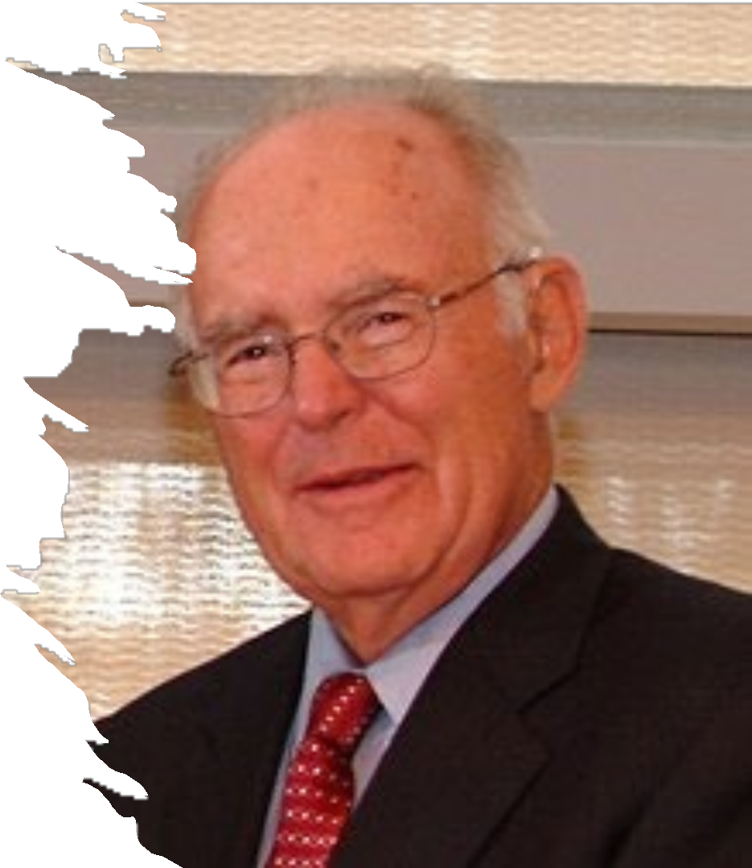
In 1965, Gordon Moore poised that roughly every two years the number of transistors on microchips will be double. Commonly referred to as Moore’s Law, this phenomenon suggests that computational progress will become significantly faster, smaller, and more efficient over time.
Historical Milestones
Gordon Moore

Slide 29
Wireless History
Ancient Systems: Smoke Signals, Carrier Pigeons, …
Radio invented in the 1880s by Marconi
Many sophisticated military radio systems were developed during and after WW2
Cellular has enjoyed exponential growth since 1988, with many billion users worldwide today
Ignited the wireless revolution
Voice, data, and multimedia becoming ubiquitous
Use in third world countries growing rapidly

Slide 30
Classification of mobile communication systems
Different mobile communication systems always exists in the different parts of the world.
So collectively we are classifying all different system on the basis of generation wise development.
They are called 0G, 1G, 2G, 3G, 4G, and 5G
Simply, the "G" stands for "GENERATION".

Slide 31
Classification of Mobile Communication Systems [T. S. Rappaport (2002)]
 | 1G | 2G | 3G | 4G
Carrier | Analog | Digital | Digital | Digital
Switching | Circuit | Circuit | Packet and Circuit | Packet
Services | Voice Only | Voice + Basic Data application | Voice + Advance Data (Multimedia) | Voice + Advance Multimedia
Capacity | Low | High | Very High | Un limited
Speed | - | Low Data Rate (up to 100 Kbps) | High Data Rate (up to 2 Mbps) | Very High Data Rate (> 100 Mbps)
Frequency Band | 800-900 MHz | 800-900 MHz | 1.8-2.5GHz | 2-8 GHz
Multiple Access | FDMA | TDMA and CDMA | Wideband Code Division Multiple Access (WCDMA), MC-CDMA, OFDM | Multi-Carrier Code Division Multiple Access. (MC-CDMA), OFDM
Notes:
Different Mobile communication systems developed in the different parts of the world simultaneously.
Collectively, they can be classified on the basis of generation wise development.
They are called 0G, 1G, 2G, 3G and 4G.

Slide 32
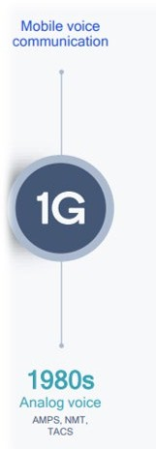
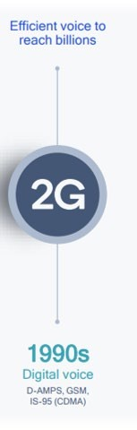
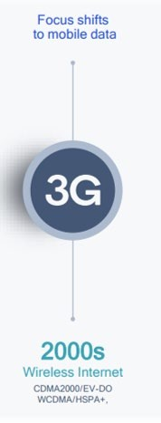
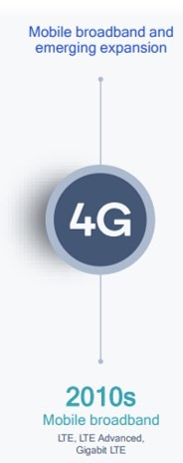
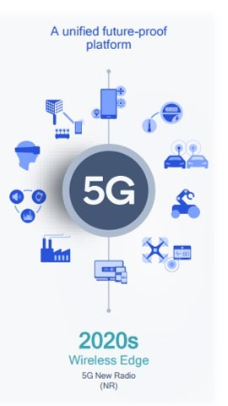



1G to 5G Evolution
Mobile Technology is Continuously evolving
Every 10 Year next generation of mobile technology evolves
Every Next generation has brought over 10X increase in Capability
AMPS: Advanced Mobile Phone System
NMT: Nordic Mobile Telephone
TACS: Total Access Communication System
GSM: Global System for Mobile communication
HSPA: High Speed Packet Access
EVDO: Evolution-Data Optimized

Slide 33

Early Mobile Telephony : 1940
0G- Zero Generation ( Mobile Radio Telephone)

Slide 34
0G- Zero Generation ( Mobile radio telephone)
Mobile radio telephone systems preceded modern cellular mobile telephony technology.
Since they were the predecessors of the first generation of cellular telephones, these systems are sometimes retroactively referred to as 0G (zero generation) systems.
Technologies used in 0G systems included the
PTT (Push to Talk or manual).
MTS (Mobile Telephone System) in 1946.
IMTS (Improved Mobile Telephone Service) in 1966.
AMTS (Advanced Mobile Telephone System) systems.
The primary users were loggers, construction foremen, realtors, and celebrities.

Slide 35

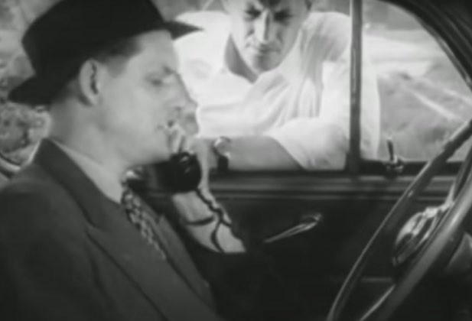


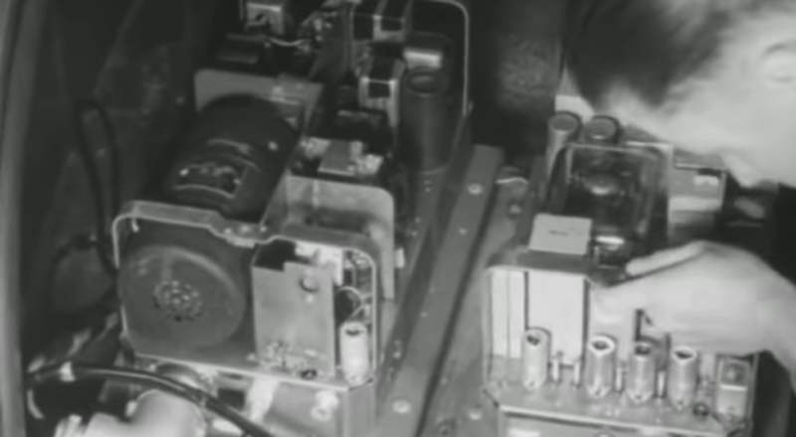


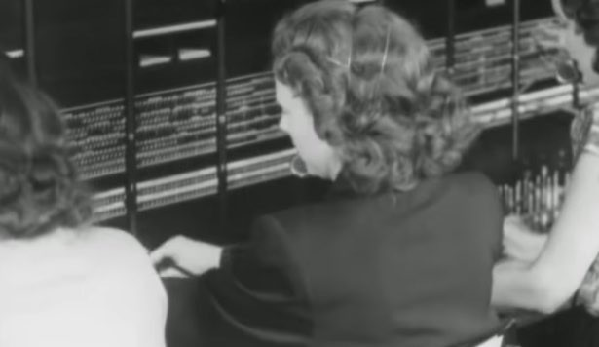

0G: Bell Lab Mobile Phone Service
Phone in Car
The 80-pound radios placed in the car
Call carried Partly on Radio and partly on PSTN
Operator Assisted
The system was demonstrated on June 17, 1946
PSTN: Public Switched Telephone Network

Slide 36

Small video by Bell labs on Early Mobile Telephony
https://www.youtube.com/watch?v=xDy2tHCPdk8

Slide 37
1G- First Generation
These are the analog cellphone standards
Introduced in the 1980s and continued until being replaced by 2G digital cellphones.
Multiple Access Techniques -- FDMA.
Provide only voice and other telephone services.
Standards used in 1G
NMT (Nordic Mobile Telephone)
AMPS (Advanced Mobile Phone System)
TACS (Total Access Communications System)
C-450

Slide 38


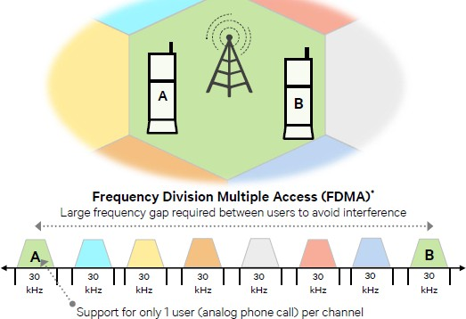








1G Radio Characteristics
800 MHz and 900 MHz
Frequency
Access technique
FDMA
Channels Bandwidth
30 KHz
Frequency Modulation (FM)
Modulation
Service
Analog voice
Image Source : Qualcomm

Slide 39


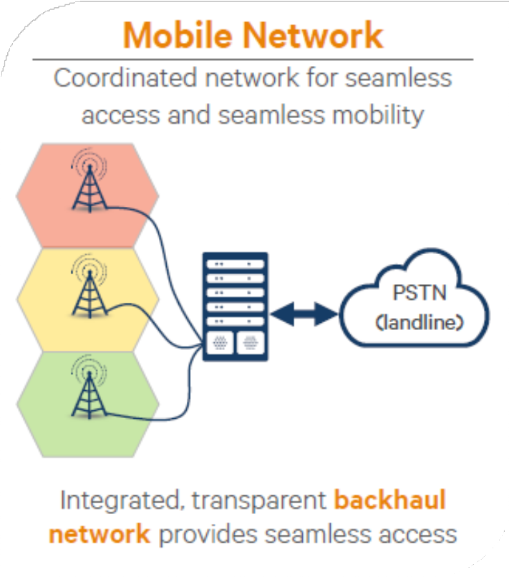

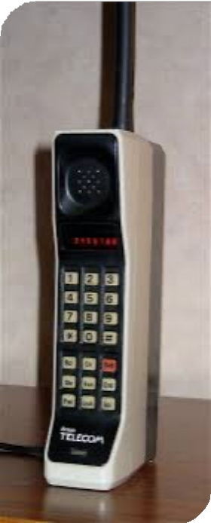






1G Network and features
Foundation of Mobile
Analog Voice Poor voice quality Large phone size Poor battery life Limited capacity Poor reliability
Image Credit : Qualcomm
PSTN: Public Switched Telephone Network

Slide 40
2G- Second Generation

Slide 41
2G- Second Generation
The technologies which are using by most’s of the today’s ubiquitous cellular networks are come under the 2G cellular standards.
These are the Digital cellphone standards.
Multiple Access Techniques -- TDMA and CDMA
Provide voice and data services.
Data speeds of up to 64 kbps
Enabled services such as SMS and MMS (Multimedia Message)
Provided better quality voice calls

Slide 42
2G standards based on TDMA
Global System for Mobile (GSM).
deployed widely in Europe, Asia, Australia, South America, and some parts of the US.
Interim standard 136 (IS-136).
widely used in North America, South America, and Australia.
Pacific Digital Cellular (PDC).
Japanese TDMA standard that is similar to IS-136.
2G standards based on CDMA
Interim standard 95 (IS-95)
It is also known as cdmaOne.
widely deployed by carriers in North America, as well as in Korea, Japan, China, South America, and Australia.

Slide 43
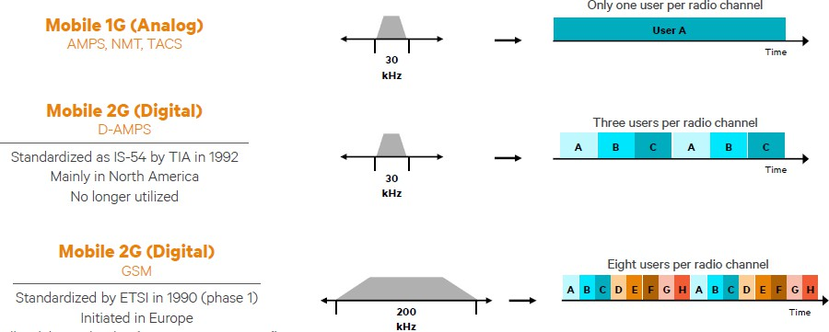
Evolution to 2G
Image Credit : Qualcomm

Slide 44
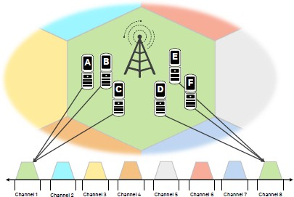
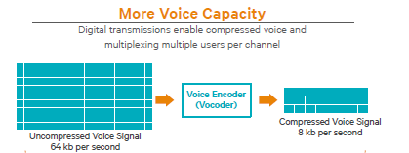
Evolution to 2G
Frequency re-use in 2G
Image Credit : Qualcomm

Slide 45
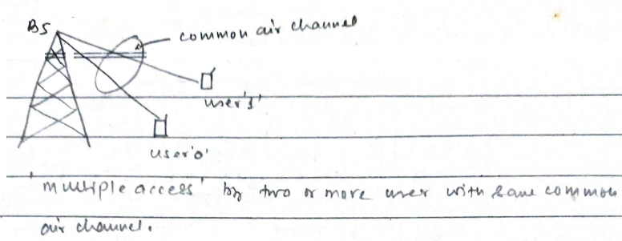
Multiple Access Techniques

Slide 46
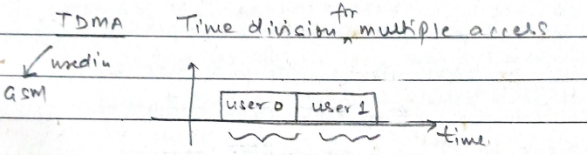
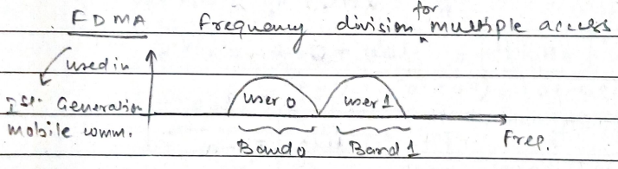
Time division multiple Access Techniques
Frequency division multiple Access Techniques

Slide 47
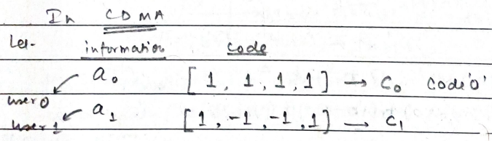
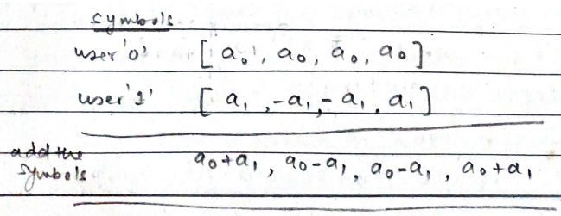
Code division multiple Access Techniques

Slide 48
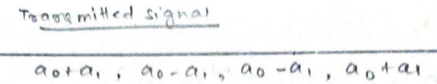
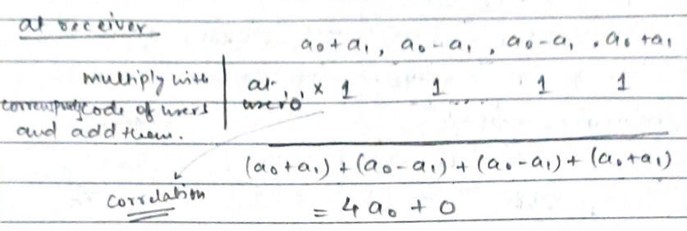
Transmitted signal
Received signal

Slide 49
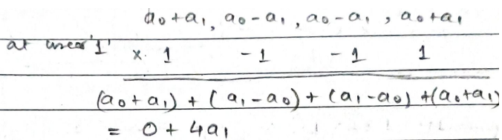
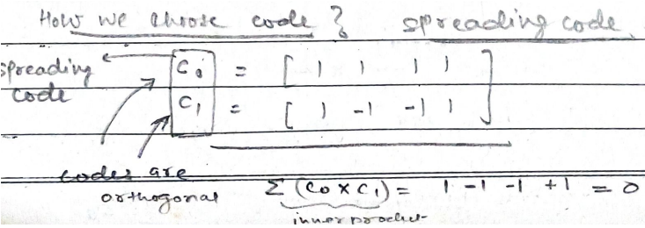
Code selection?

Slide 50
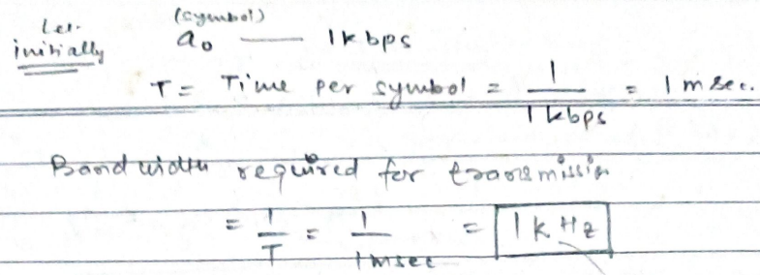
Bandwidth calculation

Slide 51
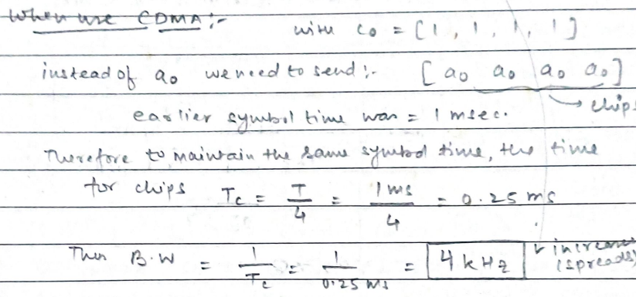
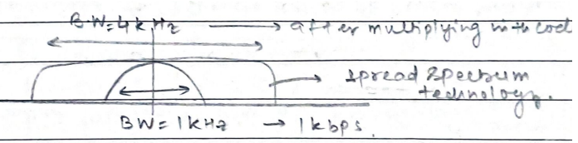
Band width in CDMA

Slide 52
Method to generate a PN sequence for CDMA?
Linear feedback shift register (LFSR)

Slide 53
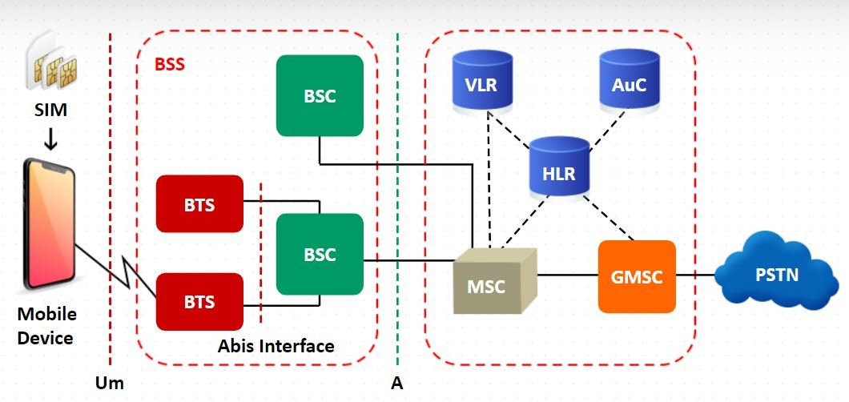








2G Network and features
Digital Voice
Increased System Capacity Mobility
SMS
Limited Data with GPRS/EDGE
SMSC
GPRS (2.5G) up to 40kbps , evolved up to 171 kbps
SIM: Subscriber Identity Module
BSS:Base Station Subsystem
BSC: Base Station Controller
MSC: Mobile Switching Center
BTS: Base Transceiver Station
VLR: Visitor Location Register
AuC: Authentication Center
PDN
HLR: Home Location Register
PDN : Public (Packet) Data Network
PSTN: Public Switched Telephone Network
GMSC: Gateway Mobile Switching Center
SMSC: Short Message Service Center
EDGE (2.75G) up to 384kbps
SGSN
GGSN
SGSN :Serving GPRS Support Node
GGSN: Gateway GPRS Support Node
GPRS: General Packet Radio Service
EDGE: (Enhanced Data rates for GSM Evolution)

Slide 54
Architecture of the GSM system
GSM is a PLMN (Public Land Mobile Network)
Components
MS (mobile station)
BS (base station)
BSC (Base switching center)
MSC (mobile switching center)
LR(Location Registers)
Subsystems
RSS (radio subsystem): covers all radio aspects
NSS (network and switching subsystem): call forwarding, handover, switching
OSS (operation subsystem): management of the network

Slide 55
GSM: elements and interfaces
radio cell
MS MS
A interface
The A interface is used to provide communication between the BSS and the MSC.
The interface carries information to enable the channels, timeslots and the like to be allocated to the mobile equipments being serviced by the BSSs.
Abis interface
This is a BSS internal interface linking the BSC and a BTS.
The Abis interface allows control of the radio equipment and radio frequency allocation in the BTS.
BSS
U_{m}
radio cell
RSS
BTS
MS
BTS
^{A}bis
BSC
BSC
A
MSC
MSC
NSS
signaling ISDN, PSTN
PDN
VLR
VLR
HLR
GMSC
IWF
BSS: Base Station Subsystem
BSC: Base Station Controller
MSC: Mobile Switching Center
BTS: Base Transceiver Station
VLR: Visitor Location Register
HLR: Home Location Register
AuC: Authentication Center
O
OSS
EIR
AUC
OMC
GMSC: Gateway Mobile Switching Center
SMSC: Short Message Service Center
SGSN :Serving GPRS Support Node
GGSN: Gateway GPRS Support Node
GPRS: General Packet Radio Service
EDGE: (Enhanced Data rates for GSM Evolution)
PDN : Public (Packet) Data Network
PSTN: Public Switched Telephone Network
ISDN: Integrated Services Digital Network

Slide 56
System Architecture: Radio subsystem
Mobile Station (MS)
Mobile Equipment (ME)
Subscriber Identity Module (SIM)
Radio subsystem
Network and switching subsystem
MS
MS
Base Station Subsystem (BSS)
Performs coding/decoding of voice
Rate adaptation to/from the wireless network.
U_{m}
BTS ^{A}bis
BSC
MSC
BTS
Base Transceiver Station (BTS)
Comprises antenna’s signal processing and amplifiers and Trans-receiver (TRX) units
Connected to MS via U_{m} interface
Connected to BSC via A_{bis} interface
Range 30-100 KM (depending upon traffic)
A
BTS
BSC
MSC
BTS
BSS

Slide 57
Radio subsystem
Base Station Controller (BSC)
Manages Radio resources for BTS
Assigns Frequency and time slots for all MS’s in its area
Handles call set up
Transcoding and rate adaptation functionality
Handover for each MS
Radio Power control
It communicates with MSC and BTS
radio cell
MS MS
BSS
U_{m}
radio cell
RSS
BTS
MS
BTS
^{A}bis
BSC
BSC
A
MSC
MSC
NSS
signaling ISDN, PSTN
PDN
VLR
VLR
HLR
GMSC
IWF
O
OSS
EIR
AUC
OMC

Slide 58
NETWORK AND SWITICHING SUBSYSTEM
Mobile Switching Center (MSC)
radio cell
MS MS
Home Location Register (HLR)
BSS
U_{m}
radio cell
Visitor Location Register (VLR)
RSS
BTS
MS
BTS
^{A}bis
BSC
BSC
A
MSC
MSC
NSS
signaling ISDN, PSTN
PDN
VLR
VLR
HLR
GMSC
IWF
O
OSS
EIR
AUC
OMC

Slide 59
Network Switching Subsystem
Mobile Switching Center (MSC)
Heart of the network
Manages communication between GSM and other networks
Call setup function and basic switching
Call routing
Billing information and collection
Mobility management
- Registration
- Location Updating
- Inter BSS and inter MSC call handoff
MSC does gateway function while its customer roams to other network by using HLR/VLR.
radio cell
MS MS
BSS
U_{m}
radio cell
RSS
BTS
MS
BTS
^{A}bis
BSC
BSC
A
MSC
MSC
NSS
signaling ISDN, PSTN
PDN
VLR
VLR
HLR
GMSC
IWF
O
OSS
EIR
AUC
OMC

Slide 60
Network Switching Subsystem
Home Location Registers (HLR)
Permanent database about mobile subscribers in a large service area (generally one per GSM network operator)
database contains IMSI (International Mobile Subscriber Identity), MSISDN (Mobile Station International Subscriber Directory Number), prepaid/postpaid, roaming restrictions, supplementary services
Visitor Location Registers (VLR)
Temporary database which updates whenever new MS enters its area, by HLR database
Controls those mobiles roaming in its area
Reduces number of queries to HLR
Database contains IMSI,TMSI (Temporary Mobile Subscriber Identity), MSISDN, MSRN (Mobile Station Roaming Number), Location Area, authentication key

Slide 61
OPERATION SUBSYSTEM
Operation and maintenance centre(OMC)
Traffic monitoring
Security management
Accounting/billing
radio cell
MS MS
BSS
U_{m}
radio cell
RSS
BTS
MS
Authentication Center (AUC)
Protects against intruders in air interface
Maintains authentication keys .
Generally associated with HLR
BTS
^{A}bis
BSC
BSC
A
Equipment Identity Register (EIR)
Database that is used to track handsets using the IMEI (International Mobile Equipment Identity)
EIR blacklist the stolen mobile
MSC
MSC
NSS
signaling ISDN, PSTN
PDN
VLR
VLR
HLR
GMSC
IWF
O
OSS
EIR
AUC
OMC

Slide 62
GSM: cellular network
use of several carrier frequencies
not the same frequency in adjoining cells
cell sizes vary from some 100 m up to 35 km depending on user density, geography, transceiver power etc.
hexagonal shape of cells is idealized (cells overlap, shapes depend on geography)
if a mobile user changes cells
handover of the connection to the neighbor cell

Slide 63
GSM frequency bands
Type | Channels | Uplink [MHz] | Downlink [MHz]
GSM 850 (Americas) | 128-251 | 824-849 | 869-894
GSM 900 | 0-124, 955-1023 | 876-915 | 921-960
classical | 124 channels | 890-915 | 935-960
extended | +49 channels | 880-915 | 925-960
GSM 1800 | 512-885 | 1710-1785 | 1805-1880
GSM 1900 (Americas) | 512-810 | 1850-1910 | 1930-1990
GSM-R | 955-1024, 0-124 | 876-915 | 921-960
exclusive | 69 channels | 876-880 | 921-925

Slide 64



Slide 65
3G- Third Generation
The 3G mobile communication systems are
IMT-2000 (International Mobile Telecommunication-2000)
The standard IMT-2000 are used in ITU (International Telecommunication
Union ).
UMTS (Universal Mobile Telecommunications systems)
The standard UMTS are used in ETSI (European Telecommunication
Standard Institute).

Slide 66
THIRD GENERATION (3G)
3G- Third Generation
3G network combines aspects of the 2G network with new technologies and protocols to deliver a significantly faster data rate.
By using packet switching, the original technology was improved to allow speeds up to 14 Mbps.
It used Wide Band Wireless Network that increased clarity.
It operates at a range of 2100MHz and has a bandwidth of 15-20MHz.
Speed of up to 2 Mbps.
Increased bandwidth, capacity and data transfer rates.
Provide voice and multimedia services like high speed internet access, video, data and high quality of image transmission.
Multiple Access Techniques -- W-CDMA

Slide 67

UMTS Frequency band

Slide 68

GSM vs UMTS

Slide 69


Evolution to 3G Network
UMTS (Universal Mobile Telecommunications systems)

Slide 70

Evolution to 3G Network
Image Credit : Qualcomm

Slide 71


Evolution of 3G to HSPA+
Image Credit : Qualcomm

Slide 72

3GPP releases of 3G

Slide 73


Slide 74













3G Network and features
Digital Voice and SMS
Mobility
Mobile web browsing WCDMA : Up to 384 kbps
HSPA : Up to 7.2 Mbps
AuC
HLR
HSPA + (3.5G) up to 71.6 Mbps
Image Sharing Video Call
RNC: Radio network Controller
HLR: Home Location Register
VLR: Visitor Location Register
AuC: Authentication Center
IMS: IP Multimedia System
MSC: Mobile Switching Center
GMSC: Gateway Mobile Switching Center
SMSC: Short Message Service Center
SGSN :Serving GPRS Support Node
GGSN: Gateway GPRS Support Node
VLR
SMSC
GPS based Services
HSPA: High speed packet access

Slide 75
4G- Fourth Generation
4G is the fourth generation of mobile network technology, succeeding 3G and preceding 5G.
It offers significantly faster data speeds than its predecessors, with download speeds typically ranging from 10 Mbps to 100 Mbps, enabling high-definition video streaming, online gaming, and faster web browsing.
4G networks have reduced latency, improving real-time applications like video conferencing, VoIP, and gaming.
4G supports a wide range of services, including mobile broadband, voice over LTE (VoLTE), and multimedia messaging, allowing for more reliable and consistent connectivity.
Since its rollout in the late 2000s, 4G has been widely adopted across the world, providing the foundation for modern mobile communications.

Slide 76
FOURTH GENERATION (4G)
4G- Fourth Generation
The key technologies that have made 4G possible are MIMO (Multiple Input Multiple Output) and OFDM (Orthogonal Frequency Division Multiplexing).
The most important 4G standards are WiMAX and LTE. While 4G LTE is a major improvement over 3G speeds, it is technically not 4G.
4G paved the way for the development of 5G, with many of its technologies and infrastructures being used as a base for the newer generation.

Slide 77
Key Parameters of 3G and 4G systems
Traits | 3G | 4G
Frequency Band | 1.8 – 2.5 GHz | 2- 8 GHz
Bandwidth | 5 to 20 MHz | 5 to 20 MHz
Max data rate | 2 Mb/s | 20 Mb/s (or 100 Mb/s)
Multiple access | W-CDMA, TDMA | MC-CDMA, OFDM
Switching | Circuit/packet | Packet
Coding | Convolutional, rates 1/2 & 1/3 | Concatenated codes, LDPC codes

Slide 78

Evolution to 4G
Carrier aggregation (CA) in 4G, specifically LTE-Advanced, is a technique that combines multiple frequency bands to create a larger bandwidth channel, thereby increasing data rates and network capacity. It allows mobile devices to utilize multiple carriers simultaneously, effectively boosting throughput and improving the user experience.
Combining Carriers:
CA involves aggregating two or more component carriers (CCs), each with a bandwidth of 1.4, 3, 5, 10, 15, or 20 MHz. In LTE-Advanced, up to five CCs can be aggregated, potentially reaching a maximum bandwidth of 100 MHz.

Slide 79

Evolution to 4G

Slide 80

Evolution to 4G
HSS : Home Subscriber Server
HLR : Home Location Register
IMS : IP Multimedia System
PSTN: Public Switched Telephone Network

Slide 81












4G Network and features
Data Only Technology
Voice over LTE Mobility
SMS
Mobile Broadband High data Rate Smart Phone Mobile APPs Social Media
High Video Consumption
Uu : Radio interface between the UE & eNodeB
S1-MME: interface between the eNodeB and MME
E-UTRAN: Evolved Universal Terrestrial Radio Access Network
HSS : Home Subscriber Server
UE: User Equipment
eNodeB: base station
MME :Mobility Management Entity
PCRF: Policy and Charging Rules Function

Slide 82





4G Radio Capabilities
1Gbps Peak Data rate
10 bps/Hz Spectral Efficiency
10 Mbps user Experience Data rate
Upto 10 ms Latency

Slide 83

5G is the fifth generation of cellular networks, bringing new capabilities that will create opportunities for people, businesses and society.

Slide 84
FIFTH GENERATION (5G)
5G uses the rarely used radio millimeter bands in the 30 GHz to 300 GHz range. Testing of 5G range in mmWave has produced results approximately 500 meters from the tower.
Using small cells, carriers using millimetre wave for the deployment of 5G can improve overall coverage area. Combined with Beamforming, small cells can deliver extremely fast coverage with low latency.
Low latency is one of 5G’s most important features. 5G uses a scalable orthogonal frequency-division multiplexing (OFDM) framework.
5G benefits greatly from this and can have latency as low as one millisecond with realistic estimates to be around 1 – 10 seconds. 5G is estimated to be 60 to 120 times faster than the average 4G latency.
With speeds of up to 10 Gbps, 5G is set to be as much as 10 times faster than 4G.
Following is a brief comparison of 2G, 3G, 4G, and 5G.

Slide 85

2G vs 3G vs 4G vs 5G
Each generation in some way has improved over its predecessor. Following is the comparison between 2G, 3G, 4G, 5G

Slide 86


High Level 5G System
5G enables a new kind of network that is designed to connect virtually everyone and everything together including machines, objects, and devices.

Slide 87

PDU (Protocol Data Unit) session

Slide 88











5G Service Based Architecture
Use plane and Control plane Separation
User Plane can be located near user
Service Based Architecture
Network Functions Connect to each other on API based interface
Control Plane
Outside Connection is also on API
Disaggregated Hardware and Software
Network can be Deployed on Virtualised / Cloud Infrastructure
UPF : User Plane Function
DN : Data Network
PCF : Policy Control Function
AF : Application Function
User Plane
UDM: Unified Data Management
NRF : Network Repository Function
NEF : Network Exposure Function
SMF : Session Management Function
AMF: Access and Mobility Management Function
AUSF : Authentication Server Function
NSSF : Network Slice Selection Function

Slide 89


Slide 90


Comparison of 4G & 5G Network
PGW : Packet Data Network Gateway
SGW: Serving Gateway

Slide 91




5G Use cases
Public Safety
eMBB
Agriculture
Health
Transport
mMTC
uRLLC
Logistics
Education
Entertainment

Slide 92

























5G Technologies
BWP : Bandwidth Part is a mechanism that allows a UE (User Equipment) to operate within a subset of the total carrier bandwidth.
NFV: Network Functions Virtualization plays a crucial role in enabling flexibility, scalability, and cost-efficiency.
IAB: Integrated Access and Backhaul is a technology that allows a single node to provide both access (connecting users) and backhaul (connecting to the core network) functions, often in a multi-hop wireless configuration.
Channel bandwidth upto 400MHz
Edge Commuting
IAB
Freq in mm Wave
Network Slicing
Side Link
Massive MIMO
NFV
Satellite Integration
BWP
Open RAN
AI/ML
And many more

Slide 93


5G Core

Slide 94


5G RAN - New Radio (NR)
Complete system: 5G RAN & Core

Slide 95


Slide 96

6G Usage Scenarios

Slide 97

6G Capabilities
9 Enhanced capabilities
6 New Capabilities

Slide 98

5G and EMF / Radiation

Slide 99

Thank You

